Slide 1
JPEG Encoder Introduction
Shan.Li

Slide 2
Pipeline
Sub-sampling
Partition
Raw Picture
Sub-sampling
Partition
Transform
Quantization
RLE
Huffman coding
Transform
Quantization
RLE & BIT
Huffman
coding
compressed
JPEG data

Slide 3
Sub-sampling
Color space transformation
First, the image should be converted from R-G-B into a different color space called Y-Cb-Cr.
Y represents the brightness of a pixel.
Cb & Cr represents the chrominance.
Sub-sampling
Due to humans can see more detail in the brightness than chrominance, YUV444 can be chroma subsampling to YUV422 or YUV420.

Slide 4
Partition
MCU (Minimum Coded Unit)
After subsampling, each channel must be split into 8x8 blocks.
MCU size become 8x8(4:4:4), 16x8(4:2:2), 16x16(4:2:0).
Exp yuv420p is like:
16
8
8
16
0 1
2 3
4
5
16
16
U
V
Y
Raw R-G-B Picture

Slide 5
Transform
From Space domain to Frequency domain
In real daily scene, the pixels in same position always have nearly value, so most of them were low frequency.
After transformation, we can reduce high frequency, and it won’t change too much by human eyes.
Pixels in picture have two dimensions: horizontal and vertical, as x and y. After transform here also have two dimensions: u and v.
U describe the pixel changed frequency in horizontal, v describe the pixel changed frequency in vertical.
Top-left is low frequency, bottom-right is high frequency

Slide 6
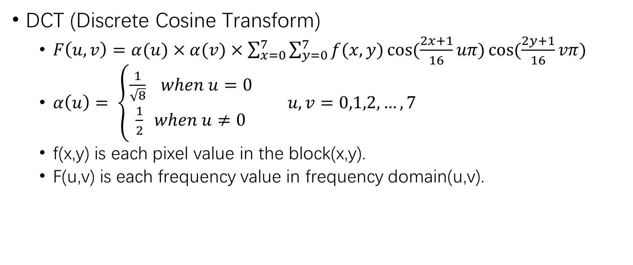
Transform
DCT (Discrete Cosine Transform)
$F\left(u,v\right)=α(u)×α(v)×\sum_{x=0}^{7}{\sum_{y=0}^{7}{f(x,y)\cos{(\frac{2x+1}{16}uπ)}\cos{(\frac{2y+1}{16}vπ)}}}$
$α\left(u\right)= \left\{\begin{aligned}\frac{1}{\sqrt{8}} when u=0 \\ \frac{1}{2} when u≠0\end{aligned}\right.$ $u,v=0,1,2,…,7$
f(x,y) is each pixel value in the block(x,y).
F(u,v) is each frequency value in frequency domain(u,v).

Slide 7
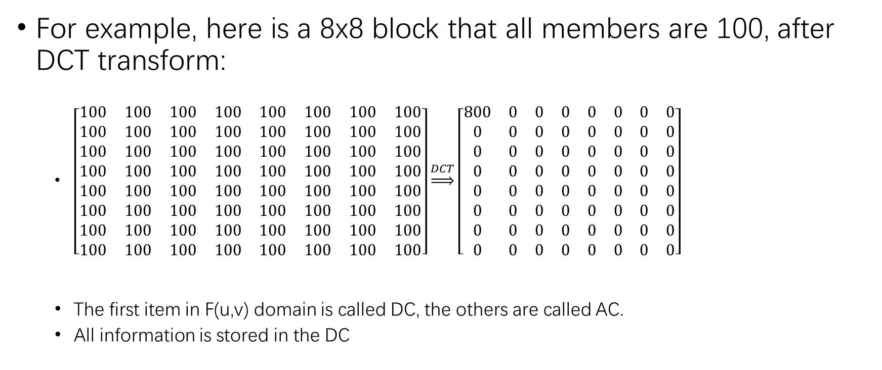
Transform
For example, here is a 8x8 block that all members are 100, after DCT transform:
$\left[\begin{matrix}100 & 100 & 100 & 100 & 100 & 100 & 100 & 100 \\ 100 & 100 & 100 & 100 & 100 & 100 & 100 & 100 \\ 100 & 100 & 100 & 100 & 100 & 100 & 100 & 100 \\ 100 & 100 & 100 & 100 & 100 & 100 & 100 & 100 \\ 100 & 100 & 100 & 100 & 100 & 100 & 100 & 100 \\ 100 & 100 & 100 & 100 & 100 & 100 & 100 & 100 \\ 100 & 100 & 100 & 100 & 100 & 100 & 100 & 100 \\ 100 & 100 & 100 & 100 & 100 & 100 & 100 & 100\end{matrix}\right]\underset{⇒}{DCT}\left[\begin{matrix}800 & 0 & 0 & 0 & 0 & 0 & 0 & 0 \\ 0 & 0 & 0 & 0 & 0 & 0 & 0 & 0 \\ 0 & 0 & 0 & 0 & 0 & 0 & 0 & 0 \\ 0 & 0 & 0 & 0 & 0 & 0 & 0 & 0 \\ 0 & 0 & 0 & 0 & 0 & 0 & 0 & 0 \\ 0 & 0 & 0 & 0 & 0 & 0 & 0 & 0 \\ 0 & 0 & 0 & 0 & 0 & 0 & 0 & 0 \\ 0 & 0 & 0 & 0 & 0 & 0 & 0 & 0\end{matrix}\right]$
The first item in F(u,v) domain is called DC, the others are called AC.
All information is stored in the DC
f(x,y)
F(u,v)

Slide 8
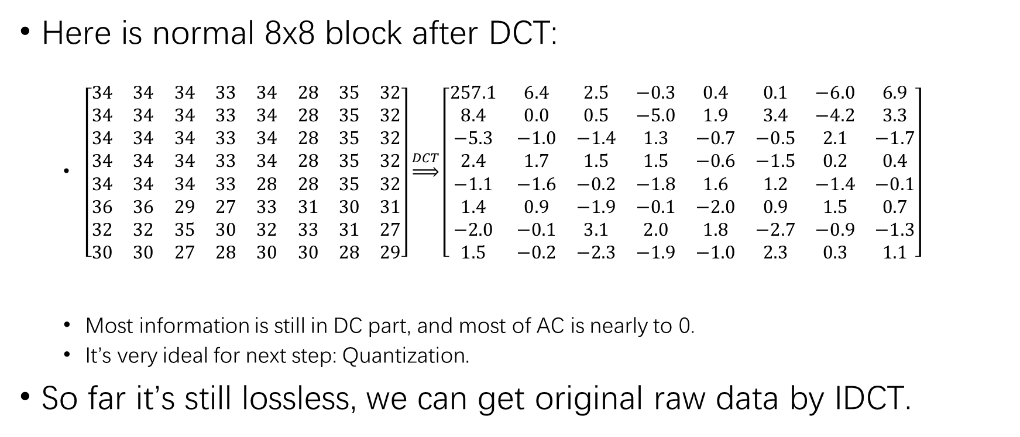
Transform
Here is normal 8x8 block after DCT:
$\left[\begin{matrix}34 & 34 & 34 & 33 & 34 & 28 & 35 & 32 \\ 34 & 34 & 34 & 33 & 34 & 28 & 35 & 32 \\ 34 & 34 & 34 & 33 & 34 & 28 & 35 & 32 \\ 34 & 34 & 34 & 33 & 34 & 28 & 35 & 32 \\ 34 & 34 & 34 & 33 & 28 & 28 & 35 & 32 \\ 36 & 36 & 29 & 27 & 33 & 31 & 30 & 31 \\ 32 & 32 & 35 & 30 & 32 & 33 & 31 & 27 \\ 30 & 30 & 27 & 28 & 30 & 30 & 28 & 29\end{matrix}\right]\underset{⇒}{DCT}\left[\begin{matrix}257.1 & 6.4 & 2.5 & −0.3 & 0.4 & 0.1 & −6.0 & 6.9 \\ 8.4 & 0.0 & 0.5 & −5.0 & 1.9 & 3.4 & −4.2 & 3.3 \\ −5.3 & −1.0 & −1.4 & 1.3 & −0.7 & −0.5 & 2.1 & −1.7 \\ 2.4 & 1.7 & 1.5 & 1.5 & −0.6 & −1.5 & 0.2 & 0.4 \\ −1.1 & −1.6 & −0.2 & −1.8 & 1.6 & 1.2 & −1.4 & −0.1 \\ 1.4 & 0.9 & −1.9 & −0.1 & −2.0 & 0.9 & 1.5 & 0.7 \\ −2.0 & −0.1 & 3.1 & 2.0 & 1.8 & −2.7 & −0.9 & −1.3 \\ 1.5 & −0.2 & −2.3 & −1.9 & −1.0 & 2.3 & 0.3 & 1.1\end{matrix}\right]$
Most information is still in DC part, and most of AC is nearly to 0.
It’s very ideal for next step: Quantization.
So far it’s still lossless, we can get original raw data by IDCT.
f(x,y)
F(u,v)

Slide 9
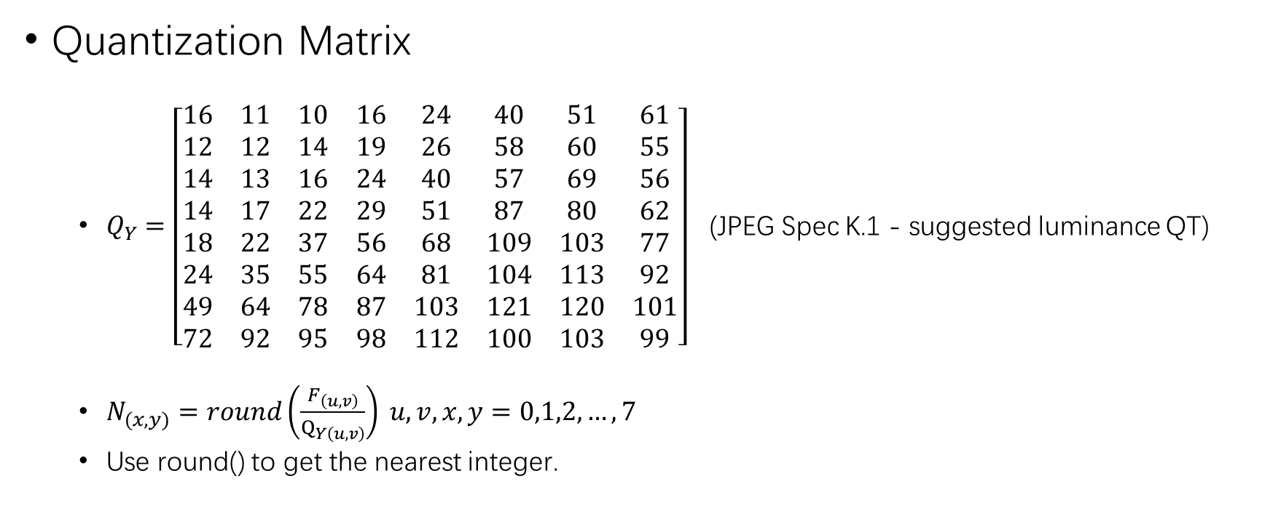
Quantization
Quantization Matrix
$Q_{Y}=\left[\begin{matrix}16 & 11 & 10 & 16 & 24 & 40 & 51 & 61 \\ 12 & 12 & 14 & 19 & 26 & 58 & 60 & 55 \\ 14 & 13 & 16 & 24 & 40 & 57 & 69 & 56 \\ 14 & 17 & 22 & 29 & 51 & 87 & 80 & 62 \\ 18 & 22 & 37 & 56 & 68 & 109 & 103 & 77 \\ 24 & 35 & 55 & 64 & 81 & 104 & 113 & 92 \\ 49 & 64 & 78 & 87 & 103 & 121 & 120 & 101 \\ 72 & 92 & 95 & 98 & 112 & 100 & 103 & 99\end{matrix}\right]$ (JPEG Spec K.1 - suggested luminance QT)
$N_{(x,y)}=round\left(\frac{F_{\left(u,v\right)}}{Q_{Y\left(u,v\right)}}\right) u,v,x,y=0,1,2,…,7$
Use round() to get the nearest integer.

Slide 10
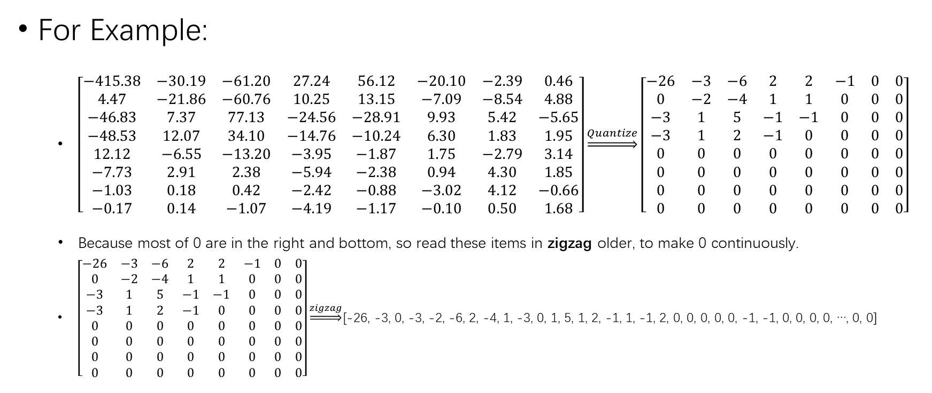
Quantization
For Example:
$\left[\begin{matrix}−415.38 & −30.19 & −61.20 & 27.24 & 56.12 & −20.10 & −2.39 & 0.46 \\ 4.47 & −21.86 & −60.76 & 10.25 & 13.15 & −7.09 & −8.54 & 4.88 \\ −46.83 & 7.37 & 77.13 & −24.56 & −28.91 & 9.93 & 5.42 & −5.65 \\ −48.53 & 12.07 & 34.10 & −14.76 & −10.24 & 6.30 & 1.83 & 1.95 \\ 12.12 & −6.55 & −13.20 & −3.95 & −1.87 & 1.75 & −2.79 & 3.14 \\ −7.73 & 2.91 & 2.38 & −5.94 & −2.38 & 0.94 & 4.30 & 1.85 \\ −1.03 & 0.18 & 0.42 & −2.42 & −0.88 & −3.02 & 4.12 & −0.66 \\ −0.17 & 0.14 & −1.07 & −4.19 & −1.17 & −0.10 & 0.50 & 1.68\end{matrix}\right]\underset{⇒}{Quantize}\left[\begin{matrix}−26 & −3 & −6 & 2 & 2 & −1 & 0 & 0 \\ 0 & −2 & −4 & 1 & 1 & 0 & 0 & 0 \\ −3 & 1 & 5 & −1 & −1 & 0 & 0 & 0 \\ −3 & 1 & 2 & −1 & 0 & 0 & 0 & 0 \\ 0 & 0 & 0 & 0 & 0 & 0 & 0 & 0 \\ 0 & 0 & 0 & 0 & 0 & 0 & 0 & 0 \\ 0 & 0 & 0 & 0 & 0 & 0 & 0 & 0 \\ 0 & 0 & 0 & 0 & 0 & 0 & 0 & 0\end{matrix}\right]$
Because most of 0 are in the right and bottom, so read these items in zigzag older, to make 0 continuously.
$\left[\begin{matrix}−26 & −3 & −6 & 2 & 2 & −1 & 0 & 0 \\ 0 & −2 & −4 & 1 & 1 & 0 & 0 & 0 \\ −3 & 1 & 5 & −1 & −1 & 0 & 0 & 0 \\ −3 & 1 & 2 & −1 & 0 & 0 & 0 & 0 \\ 0 & 0 & 0 & 0 & 0 & 0 & 0 & 0 \\ 0 & 0 & 0 & 0 & 0 & 0 & 0 & 0 \\ 0 & 0 & 0 & 0 & 0 & 0 & 0 & 0 \\ 0 & 0 & 0 & 0 & 0 & 0 & 0 & 0\end{matrix}\right]\underset{⇒}{zigzag}$[-26, -3, 0, -3, -2, -6, 2, -4, 1, -3, 0, 1, 5, 1, 2, -1, 1, -1, 2, 0, 0, 0, 0, 0, -1, -1, 0, 0, 0, 0, …, 0, 0]

Slide 11
RLE (Run-Length Encoding)
Put zeros and next non-zero num in the same group
If zeros num is more than 16(except the last group), then let first 16 zeros in an addition group.
If the last group numbers are only zero, just use EOB, which means there only have zero in the end.
35, 7, 0, 0, 0, -6, -2, 0, 0, -9, 0, 0, 0, 0, 0, 0, 0, 0, 0, 0, 0, 0, 0, 0, 0, 0, 0, 0, 8, 0, 0, 0, …, 0
35 | 7 | 0, 0, 0, -6 | -2 | 0, 0, 9 | 0, …, 0, 8 | 0, 0, …, 0
35, 7, 0, 0, 0, -6, -2, 0, 0, -9, 0, 0, 0, 0, 0, 0, 0, 0, 0, 0, 0, 0, 0, 0, 0, 0, 0, 0, 8, 0, 0, 0, …, 0
35 | 7 | 0, 0, 0, -6 | -2 | 0, 0, 9 | 0, …, 0, 8 |  | 0, 0, …, 0
35 | 7 | 0, 0, 0, -6 | -2 | 0, 0, 9 | 0, 0, …, 0 | 0, 0, 8 | EOB

Slide 12
RLE (Run-Length Encoding)
Use two numbers to describe each group
1st num means zeros num.
2nd num means the non-zero num.
(15, 0) means 16 zeros, (15, x) means 15 zeros and one non-zero.
35, 7, 0, 0, 0, -6, -2, 0, 0, -9, 0, 0, 0, 0, 0, 0, 0, 0, 0, 0, 0, 0, 0, 0, 0, 0, 0, 0, 8, 0, 0, 0, …, 0
35 | 7 | 0, 0, 0, -6 | -2 | 0, 0, 9 | 0, …, 0, 8 |  | 0, 0, …, 0
35 | 7 | 0, 0, 0, -6 | -2 | 0, 0, 9 | 0, 0, …, 0 | 0, 0, 8 | EOB
(0, 35) | (0, 7) | (3, -6) | (0, -2) | (2, 9) | (15, 0) | (2, 8) | EOB

Slide 13
BIT Coding
Non-zero part
The non-zero part range is [-2047 ~ 2047], use standard table for this part coding. (in next page)
For example, the first non-zero num is 35, it’s in the table that size is 6, and the bits is “100011”. And “-6” is in the table size is 3, the bits is“001”.
Use (zero num, bits size, bits) to show each group.
35, 7, 0, 0, 0, -6, -2, 0, 0, -9, 0, 0, 0, 0, 0, 0, 0, 0, 0, 0, 0, 0, 0, 0, 0, 0, 0, 0, 8, 0, 0, 0, …, 0
35 | 7 | 0, 0, 0, -6 | -2 | 0, 0, 9 | 0, …, 0, 8 |  | 0, 0, …, 0
35 | 7 | 0, 0, 0, -6 | -2 | 0, 0, 9 | 0, 0, …, 0 | 0, 0, 8 | EOB
(0, 35) | (0, 7) | (3, -6) | (0, -2) | (2, 9) | (15, 0) | (2, 8) | EOB
(0,6,100011) | (0,3,111) | (3,3,001) | (0,2,01) | (2,4,0110) | (15,-) | (2,4,1000) | EOB

Slide 14
Value |  | Size | Bits
0 |  | 0 | –
-1 | 1 | 1 | 0 | 1
-3,-2 | 2,3 | 2 | 00,01 | 10,11
-7,-6,-5,-4 | 4,5,6,7 | 3 | 000,001,010,011 | 100,101,110,111
-15,…,-8 | 8,…,15 | 4 | 0000,…,0111 | 1000,…,1111
-31,…,-16 | 16,…,31 | 5 | 0 0000,…,0 1111 | 1 0000,…,1 1111
-63,…,-32 | 32,…,63 | 6 | 00 0000,… | …,11 1111
-127,…,-64 | 64,…,127 | 7 | 000 0000,… | …,111 1111
-255,…,-128 | 128,…,255 | 8 | 0000 0000,… | …,1111 1111
-511,…,-256 | 256,…,511 | 9 | 0 0000 0000,… | …,1 1111 1111
-1023,…,-512 | 512,…,1023 | 10 | 00 0000 0000,… | …,11 1111 1111
-2047,…,-1024 | 1024,…,2047 | 11 | 000 0000 0000,… | …,111 1111 1111

Slide 15
BIT Coding
Both 1st and 2nd num in each group are in the range [0, 15], so we can only use one byte to show them
Zero num use high 4 bits.
Bits size use low 4 bits.
35, 7, 0, 0, 0, -6, -2, 0, 0, -9, 0, 0, 0, 0, 0, 0, 0, 0, 0, 0, 0, 0, 0, 0, 0, 0, 0, 0, 8, 0, 0, 0, …, 0
35 | 7 | 0, 0, 0, -6 | -2 | 0, 0, 9 | 0, …, 0, 8 |  | 0, 0, …, 0
35 | 7 | 0, 0, 0, -6 | -2 | 0, 0, 9 | 0, 0, …, 0 | 0, 0, 8 | EOB
(0, 35) | (0, 7) | (3, -6) | (0, -2) | (2, 9) | (15, 0) | (2, 8) | EOB
(0,6,100011) | (0,3,111) | (3,3,001) | (0,2,01) | (2,4,0110) | (15,-) | (2,4,1000) | EOB
(0x6, 100011) | (0x3,111) | (0x33,001) | (0x2,01) | (0x24,0110) | 0xF0 | (0x24,1000) | EOB

Slide 16
Huffman Coding
First byte in each group use huffman coding.
Huffman Table has two parts, DC and AC. (next page)
DC don’t have any preposed zero num, so the buffman table range is 0 ~ 15.
For example, DC first byte is 0x6, so we can get “100” from the table.
AC first byte range is 0 ~ FF, so the table is bigger.

Slide 17
Length | Value | Bits
3 bits | 04 05 03 02 06 01 00 (EOB) | 000 001 010 011 100 101 110
4 bits | 07 | 1110
5 bits | 08 | 1111 0
6 bits | 09 | 1111 10
7 bits | 0A | 1111 110
8 bits | 0B | 1111 1110
Huffman Table (DC)

Slide 18
Length | Value | Bits
2 bits | 01 02 | 00 01
3 bits | 03 | 100
4 bits | 00 (EOB) 04 11 | 1010 1011 1100
5 bits | 05 12 21 | 1101 0 1101 1 1110 0
6 bits | 31 41 | 1110 10 1110 11
… | … | …
12 bits | 24 33 62 72 | 1111 1111 0100 1111 1111 0101 1111 1111 0110 1111 1111 0111
15 bits | 82 | 1111 1111 1000 000
16 bits | 09 … FA | 1111 1111 1000 0010 … 1111 1111 1111 1110
Huffman Table (AC)

Slide 19
Huffman Coding
After Huffman coding, here is the final bits.
35, 7, 0, 0, 0, -6, -2, 0, 0, -9, 0, 0, 0, 0, 0, 0, 0, 0, 0, 0, 0, 0, 0, 0, 0, 0, 0, 0, 8, 0, 0, 0, …, 0
35 |  | 7 |  | 0, 0, 0, -6 |  | -2 |  | 0, 0, 9 |  | 0, …, 0, 8 |  |  | 0, 0, …, 0
35 |  | 7 |  | 0, 0, 0, -6 |  | -2 |  | 0, 0, 9 |  | 0, 0, …, 0 | 0, 0, 8 |  | EOB
(0, 35) |  | (0, 7) |  | (3, -6) |  | (0, -2) |  | (2, 9) |  | (15, 0) | (2, 8) |  | EOB
(0,6,100011) |  | (0,3,111) |  | (3,3,001) |  | (0,2,01) |  | (2,4,0110) |  | (15,-) | (2,4,1000) |  | EOB
(0x6, 100011) |  | (0x3,111) |  | (0x33,001) |  | (0x2,01) |  | (0x24,0110) |  | 0xF0 | (0x24,1000) |  | EOB
100 | 100011 | 100 | 111 | 11111111 0101 | 001 | 01 | 01 | 111111110100 | 0110 | 11111111001 | 111111110100 | 1000 | 1010
100100011100111111111110101001010111111111010001101111111100111111111010010001010
91 CF FE A5 7F D1 BF CF FA 45

Slide 20
About
This is for personal study
Referenced https://thecodeway.com/blog/?p=69

